Slide 1
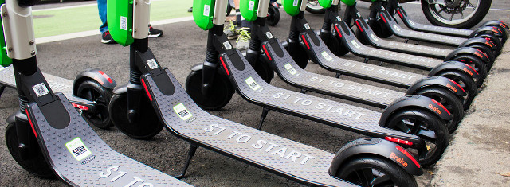

© Philipp Arnoldt
[1]
Benchmarking the Scalability Behavior of
MobilityDB and CrateDB
Eryk Kściuczyk | 3S | Bachelor Thesis Presentation | 4. September 2025

Slide 2
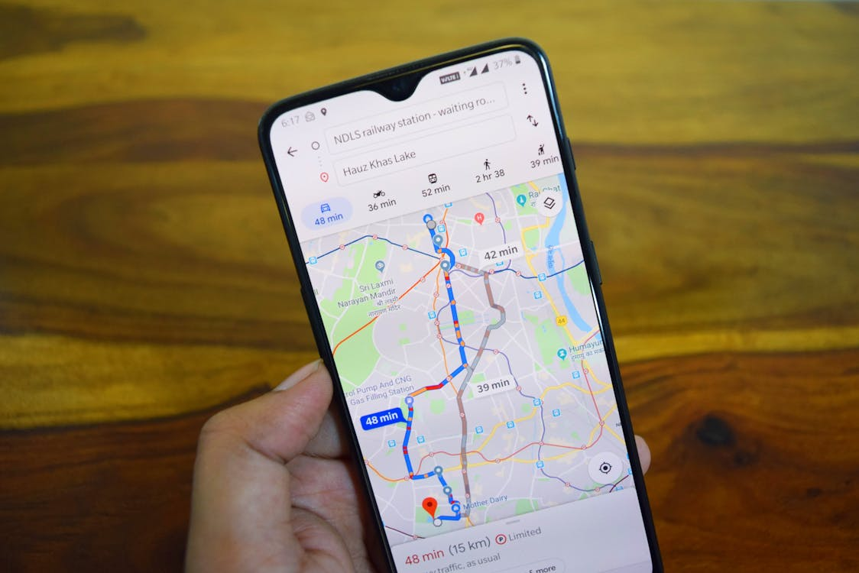
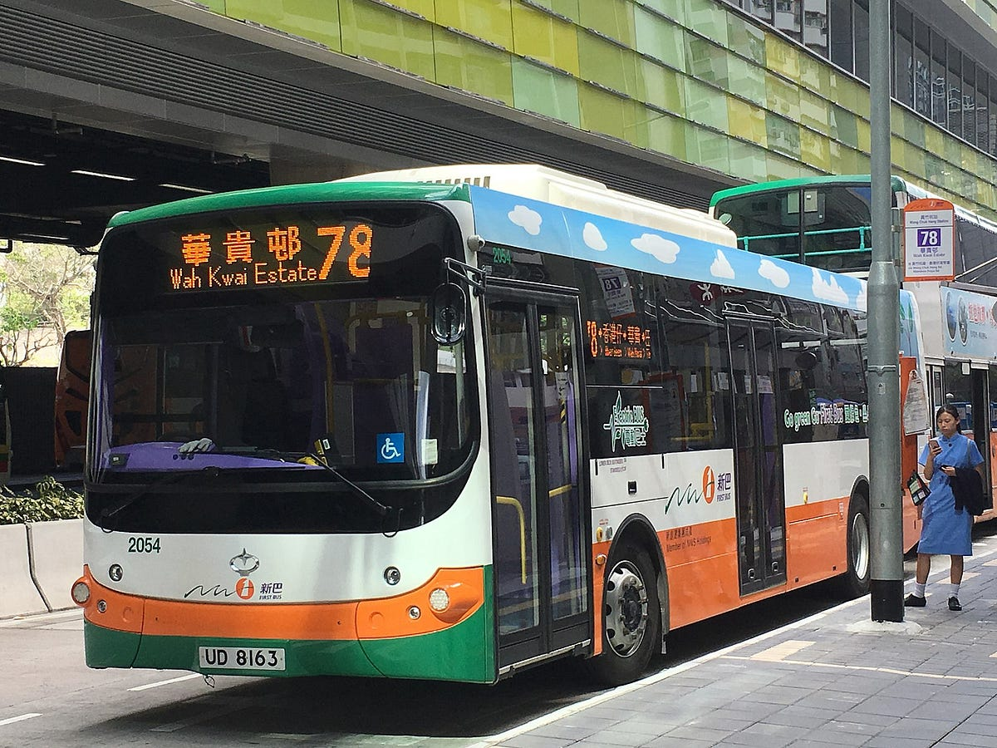

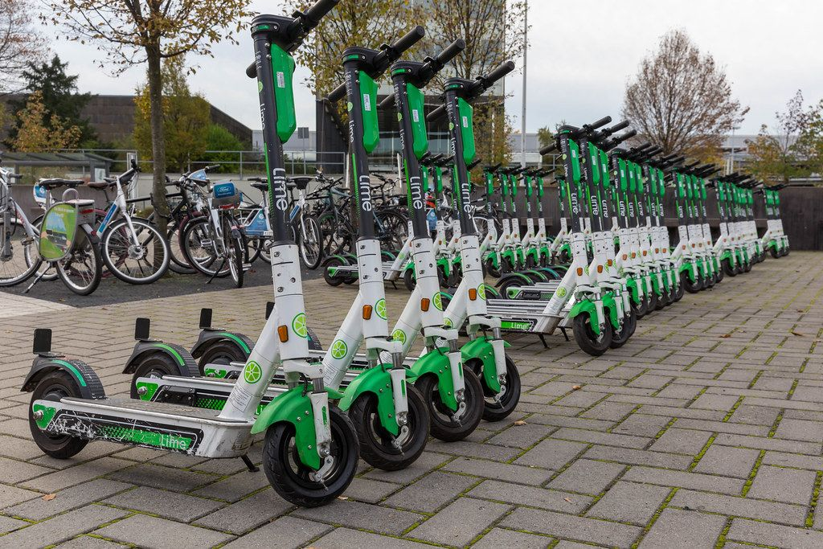


Motivation
[2]
[3]
[4]
[5]
[6]
[7]
This Photo by Unknown Author is licensed under CC BY-NC-ND

Slide 3
MobilityDB and CrateDB
CrateDB
Open Source
Eventual Consistency
Own SQL Dialect
Temporal and Geospatial functions
Designed for horizontal scaling
MobilityDBC (MobilityDB + Citus)
Open Source
ACID compliant
Extension to PostgreSQL
Spatiotemporal functions
Designed to support complex spatiotemporal queries
Horizontally scalable thanks to Citus extension

Slide 4
Background
Demonstrated horizontal scalability of MobilityDB:
Mohamed Bakli, Mahmoud Sakr, and Esteban Zimanyi. “Distributed Moving Object Data Management in MobilityDB”. In: Proceedings of the 8th ACM SIGSPATIAL International Workshop on Analytics for Big Geospatial Data. Chicago Illinois: ACM, Nov. 2019, pp. 1–10. isbn: 978-1 4503-6966-4. doi:10.1145/3356999.3365467.
Benchmarked horizontal scalability on 4 and 28 node clusters
Mohamed Bakli, Mahmoud Sakr, and Esteban Zimanyi. “Distributed Mobility Data Management in MobilityDB”. In: 21st IEEE International Conference on Mobile Data Management (MDM). June 2020

Slide 5
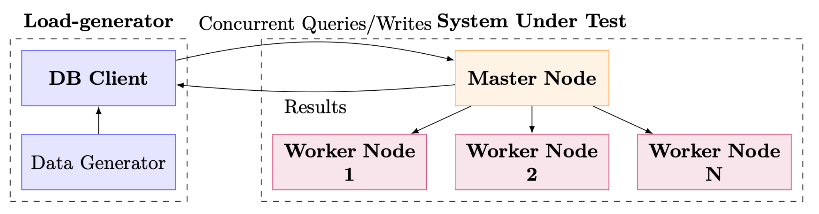
Benchmark Design

Slide 6
E-Scooter Trips Generator
Extracted from OpenStreetMap dataset:
Bike lanes
8647 Points of interest (POIs)
193 Administrative boundaries (localities)
Using the dataset and deterministic pseudorandom distributions we generated 100 Million trip events i.e. ~13GB of data.
A trip consists of multiple events, where an event stores time and location of the e-scooter.

Slide 7
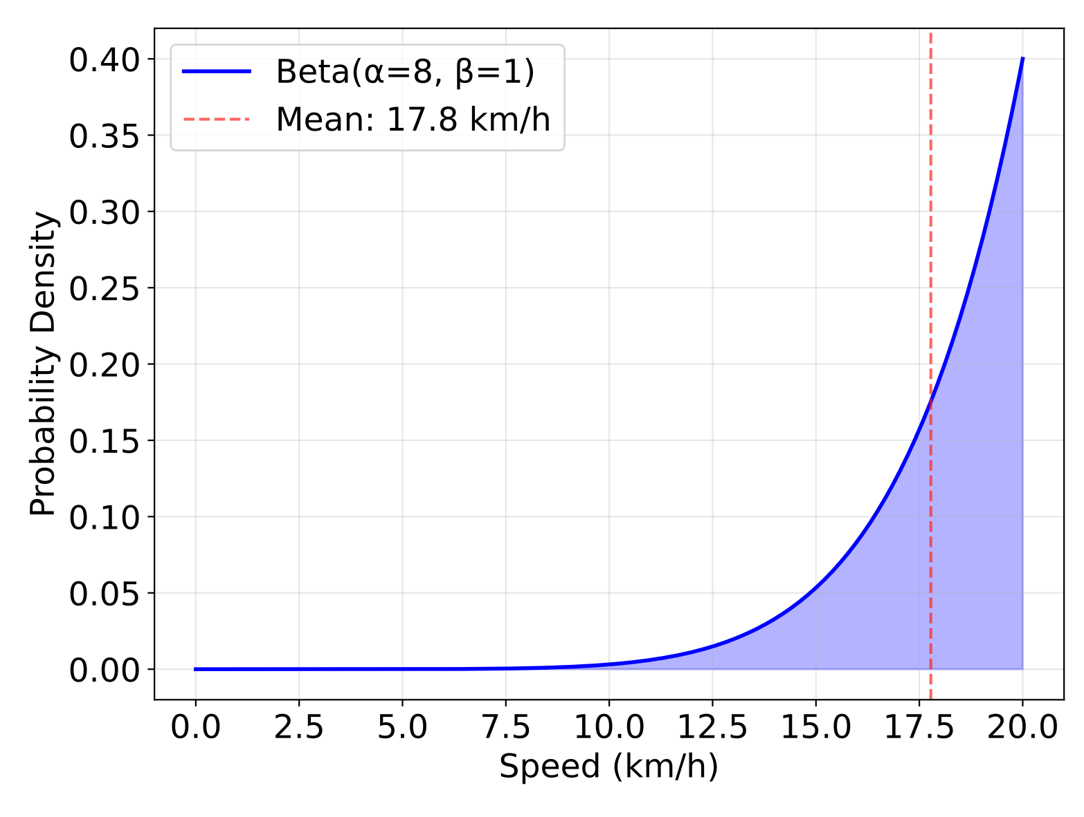
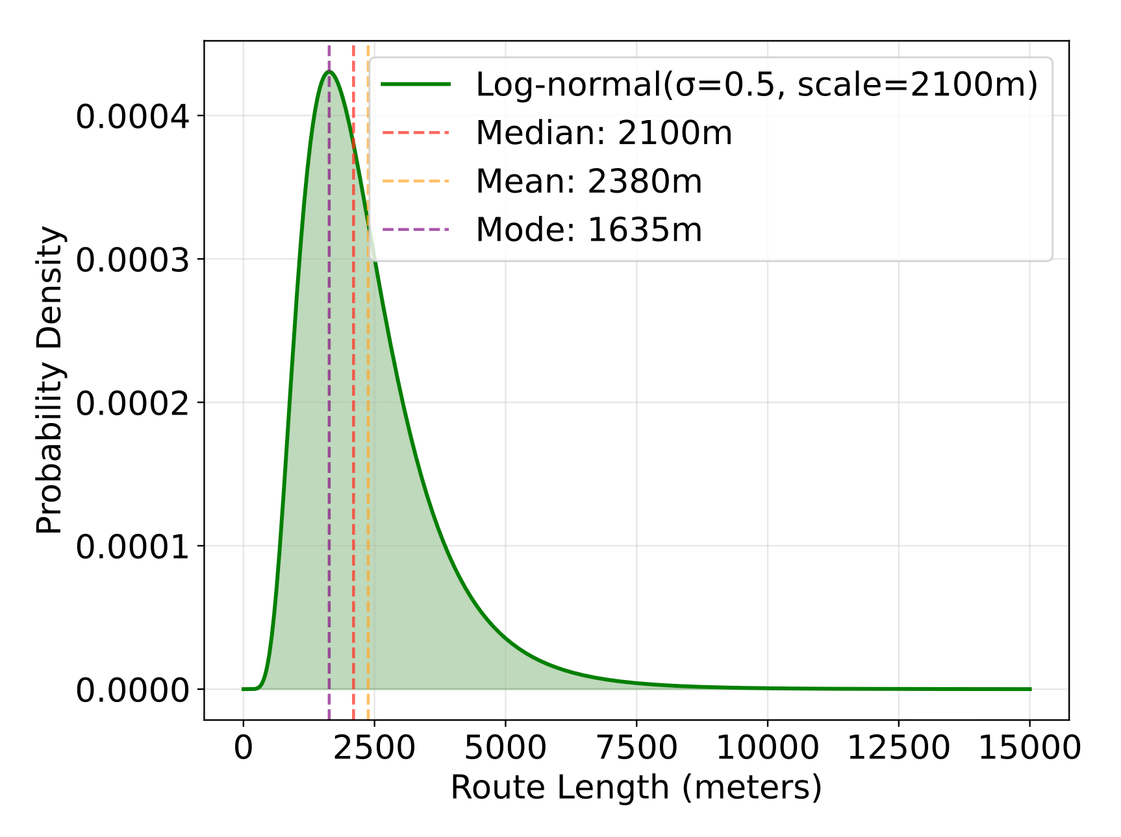
E-Scooter Trips Generator: Distributions
Beta Distribution of speed
Uniform distribution for:
Bearing of a trip
Start Point of a trip
Start time of a trip between 01.01.2020 and 31.12.2025
Log Normal Distribution of Route Length

Slide 8
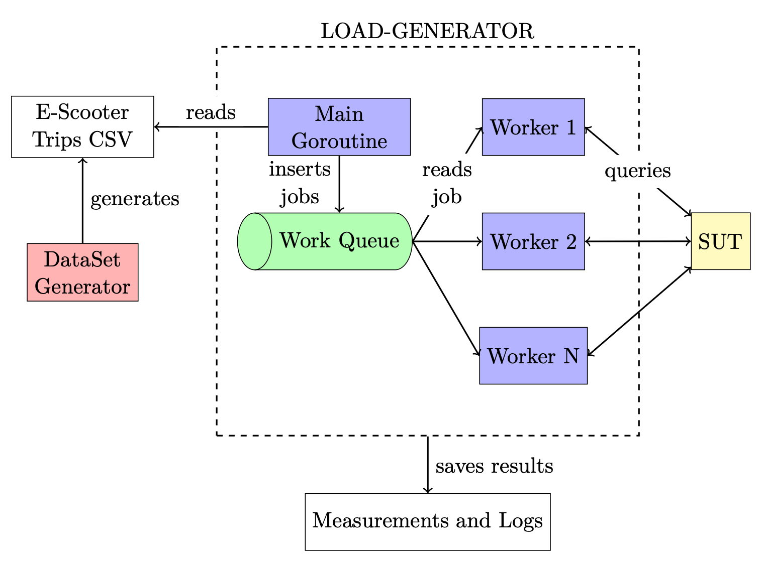
The Load-Generator: Architecture

Slide 9
The Load-Generator: Benchmark Queries
Simple queries:
Length of a trip
Trip events
Average speed of a trip
Trip start locality
Trip finish locality
First and last location of a trip
POIs close to the finish location
POIs within radius during the trip
Complex Queries:
Trips in locality
Most visited POIs
N closest trips to POI
Average trip duration per locality
Start and end in different localities
Event density heat-map per locality
Trips summaries

Slide 10
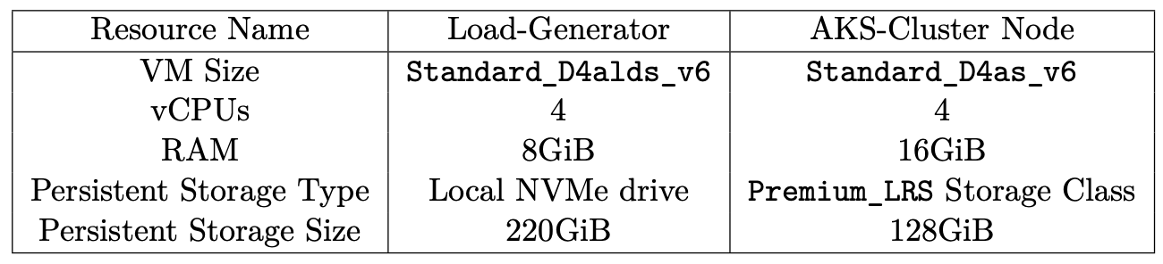
Deployment
We deployed SUTs on AKS Kubernetes cluster on Azure Cloud:
Created a custom Docker image for MobilityDB + Citus
Developed a custom Helm chart definition for MobilityDBC
Wrote Infrastructure as Code using OpenTofu for Azure Cloud
AKS Kubernetes Cluster
Load Generator VM

Slide 11
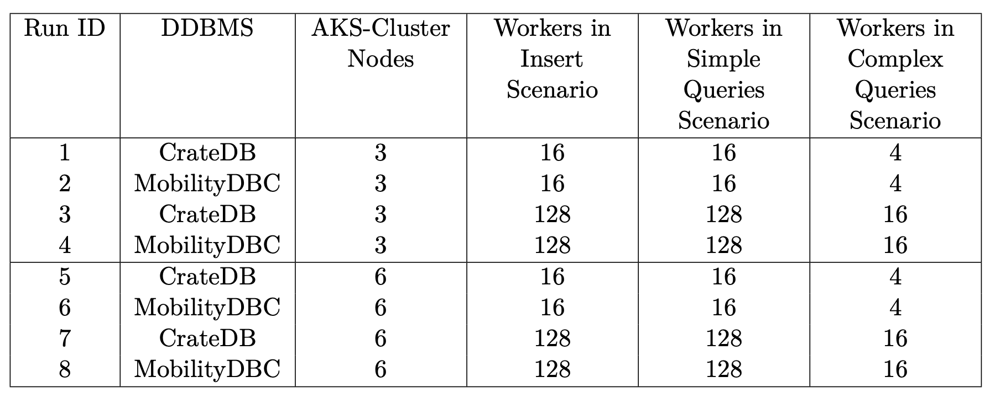
The Benchmark: Run Configurations
The Benchmark runs were performed on 4-5 August 2025

Slide 12
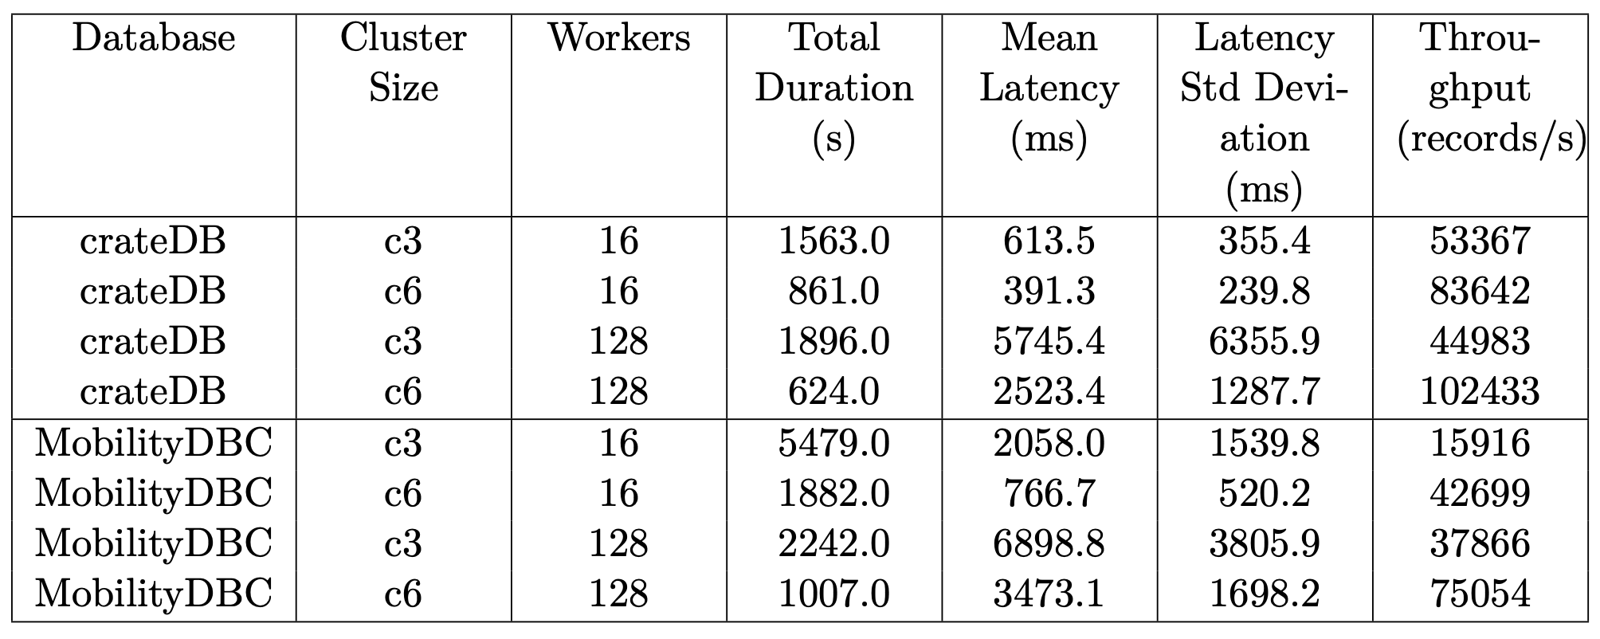
Results: Inserts
Data filtered out: first 4 minutes and last 1 minute

Slide 13
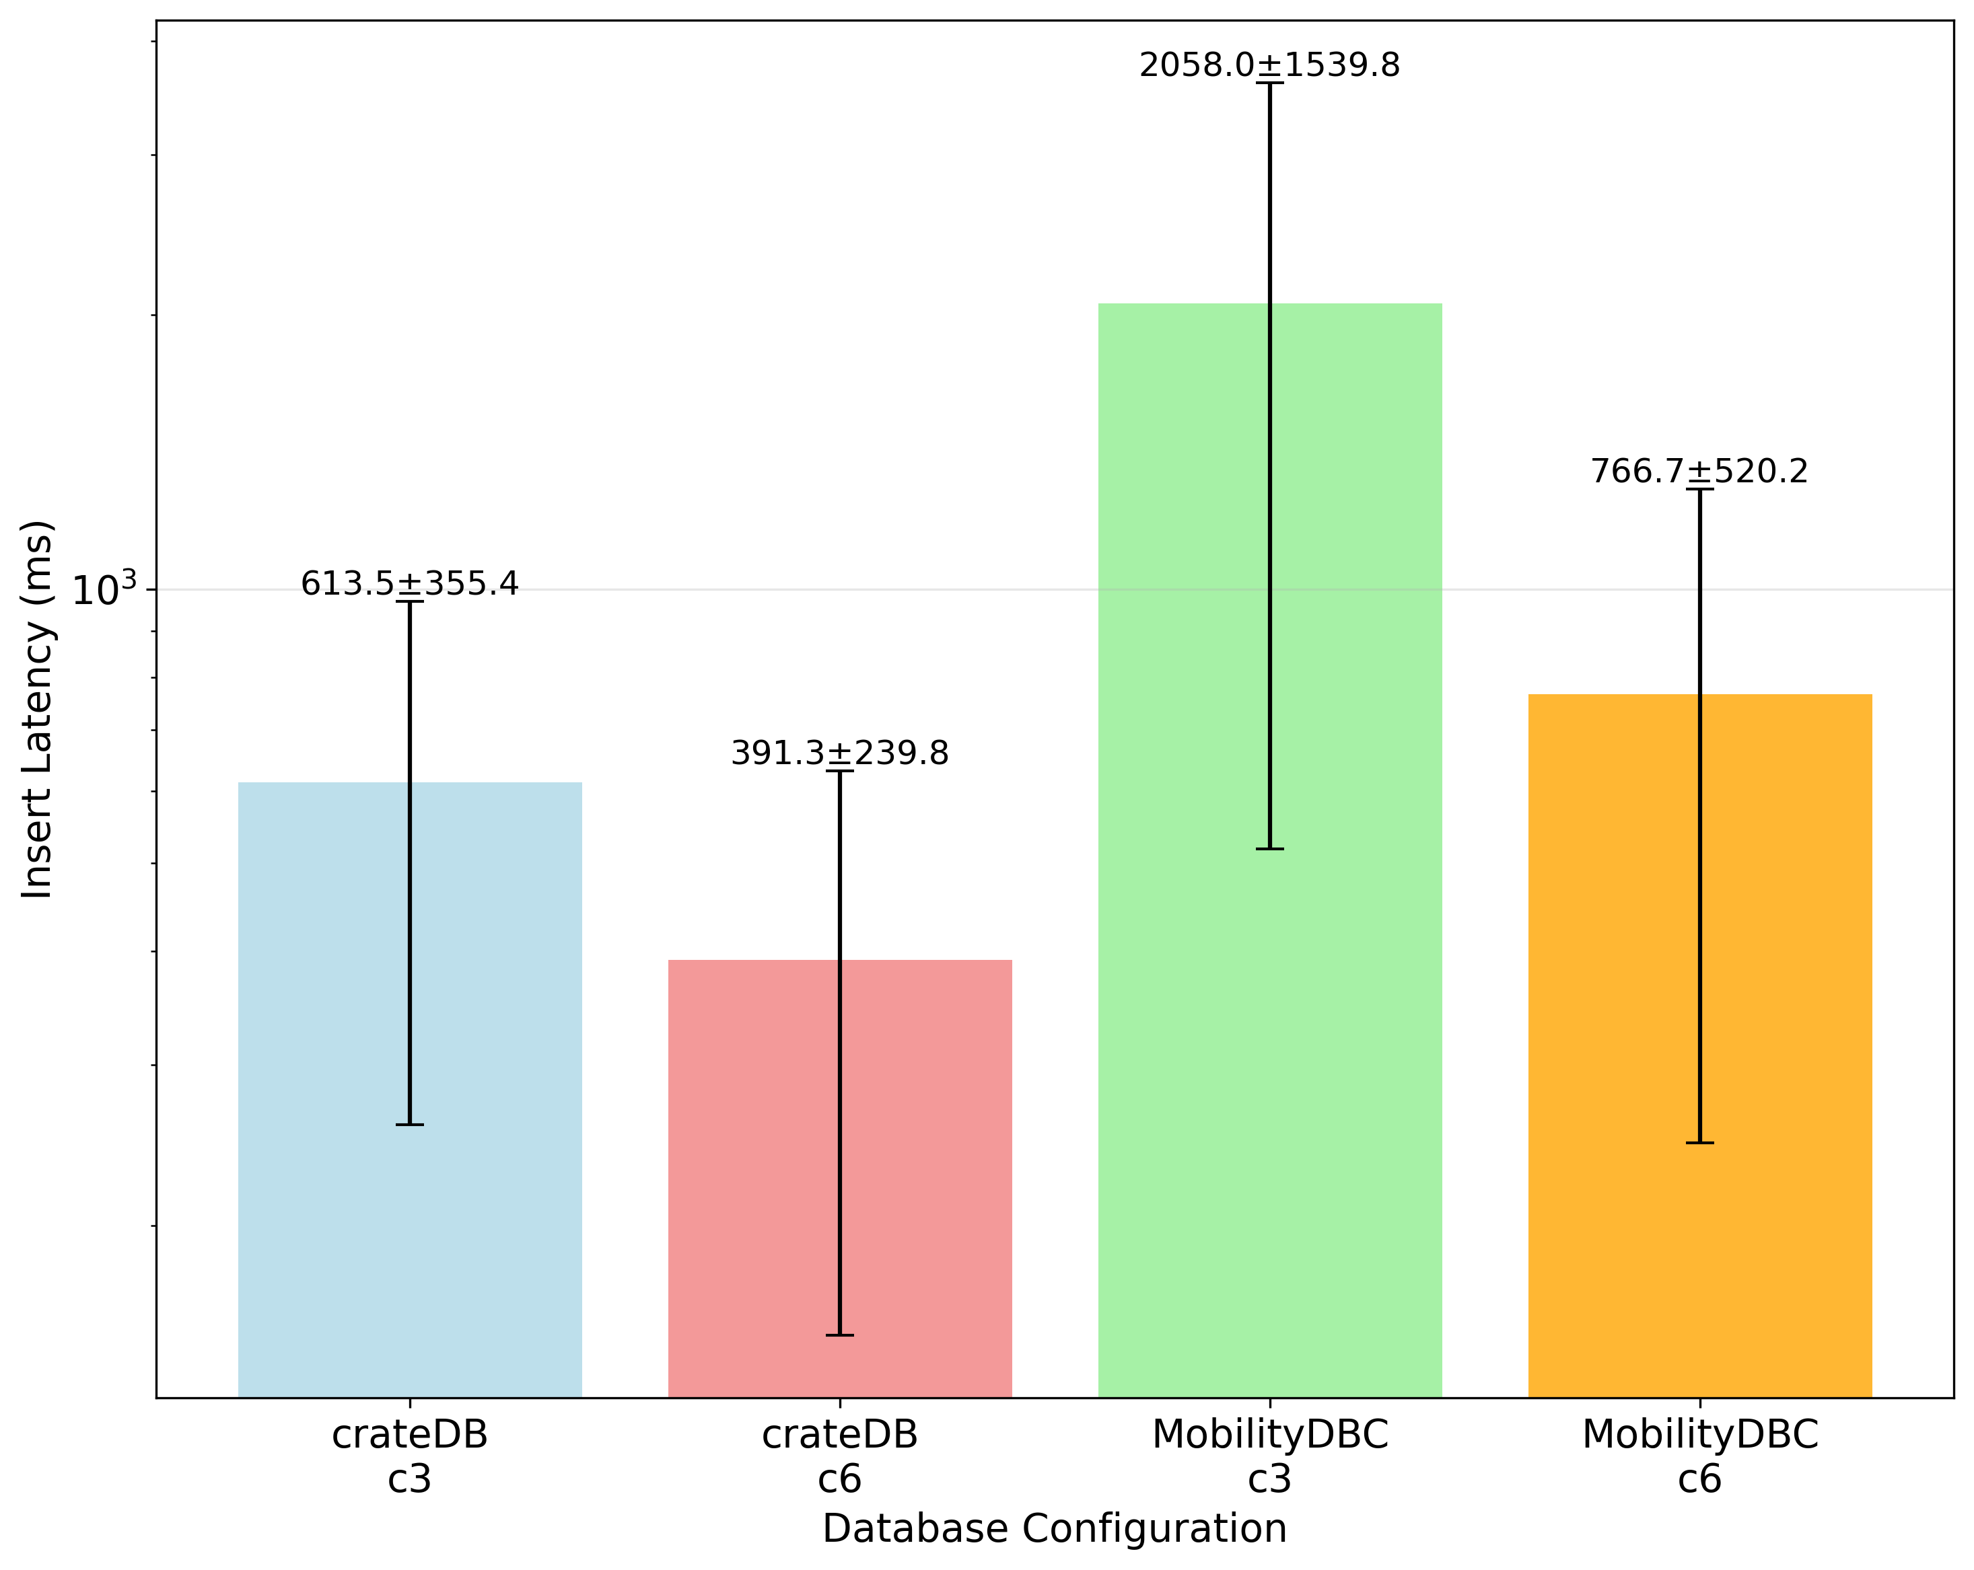
Results: Insert Latency 16 workers

Slide 14
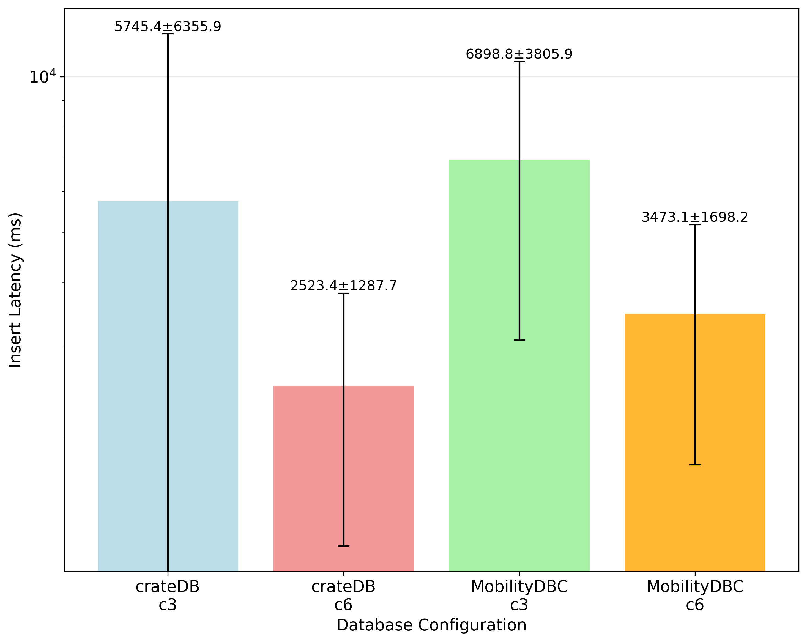
Results: Insert Latency 16 workers

Slide 15
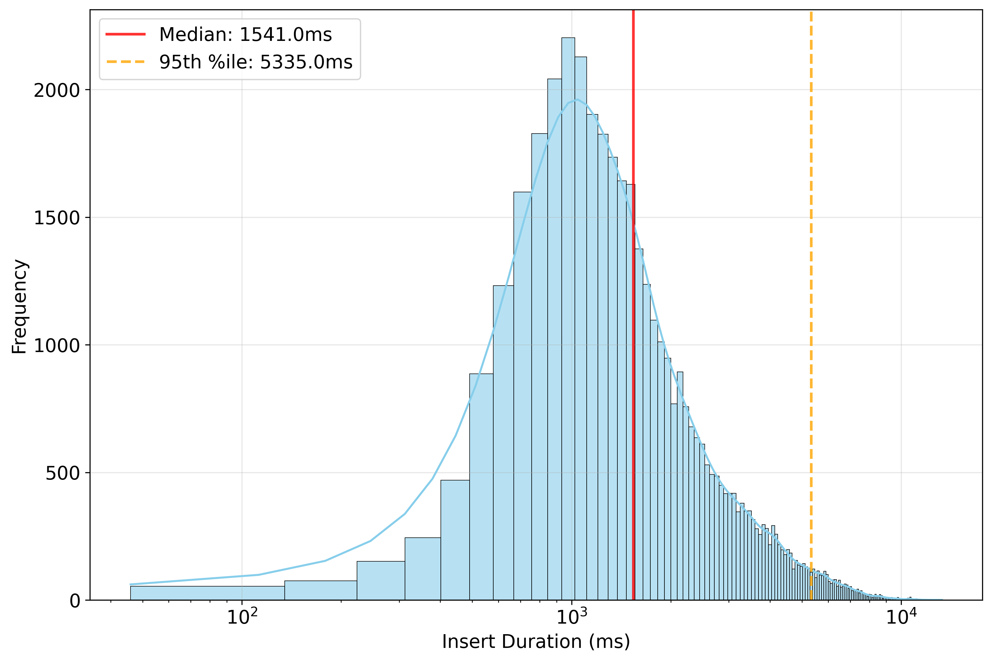
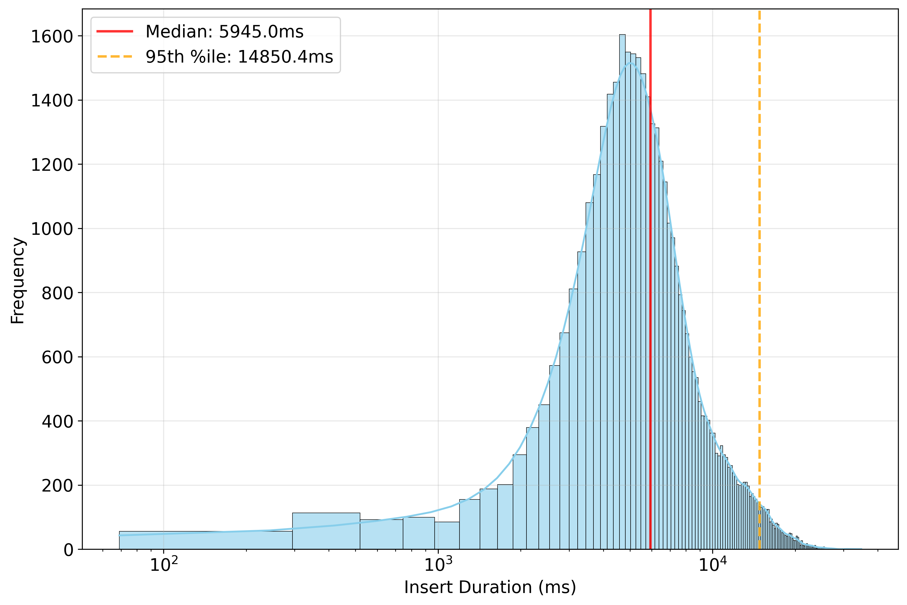
Results: Insert
3n cluster 16 workers
3n cluster 128 workers

Slide 16
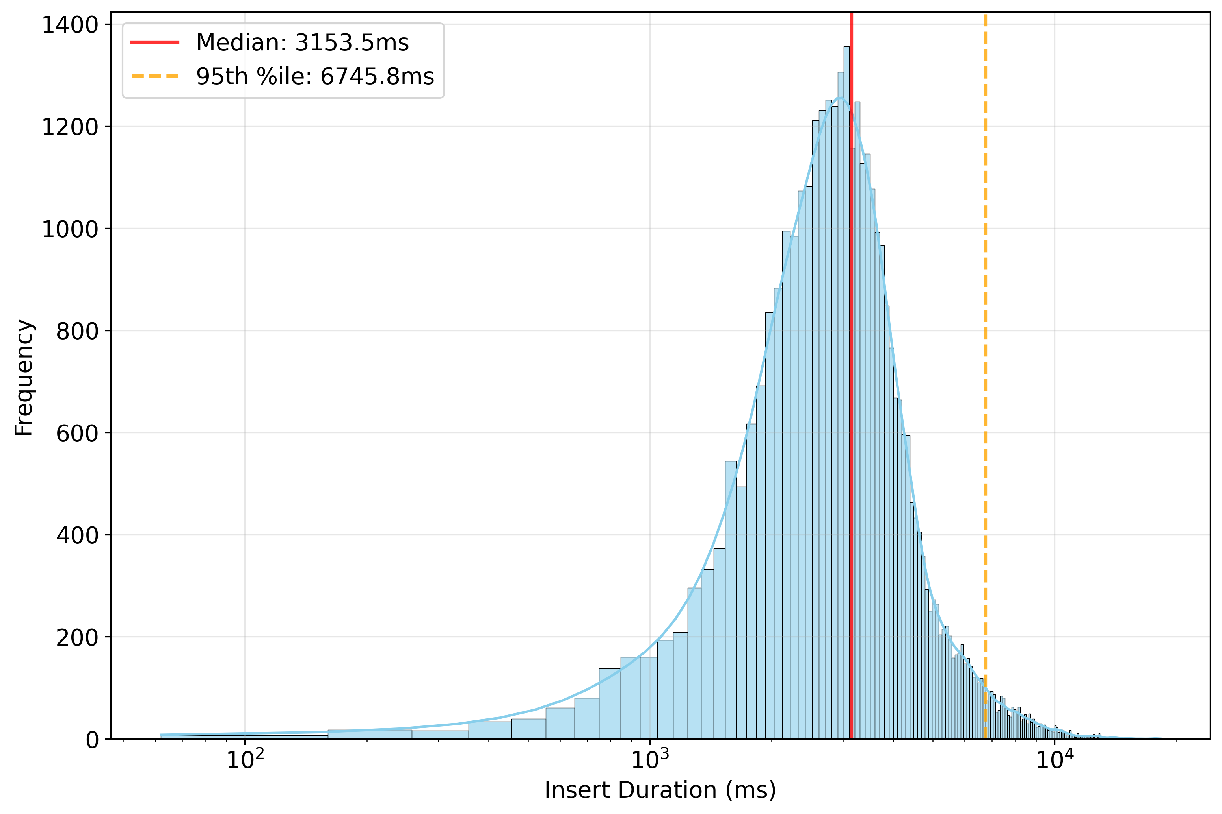
Results: Inserts
3n cluster 128 workers
6n cluster 128 workers
Lower latencies both in Median and 95th percentile; Similar results for CrateDB

Slide 17
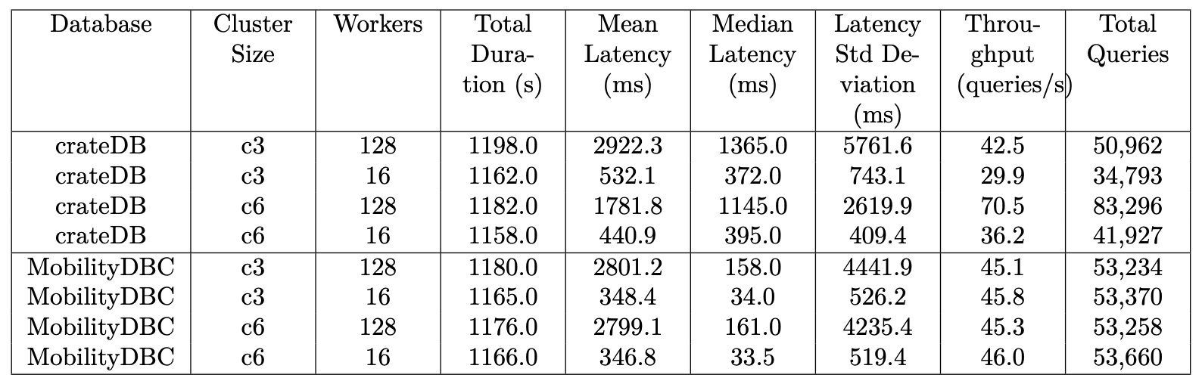
Results: Simple Queries

Slide 18
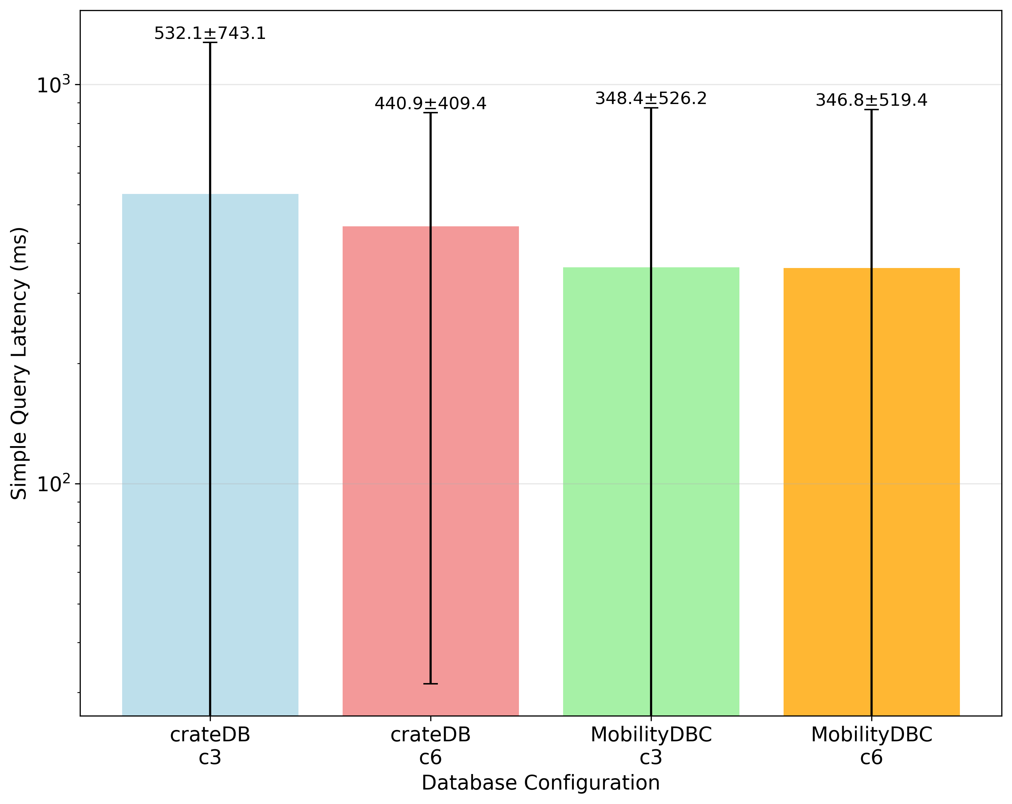
Results: Simple Queries 16 Workers

Slide 19
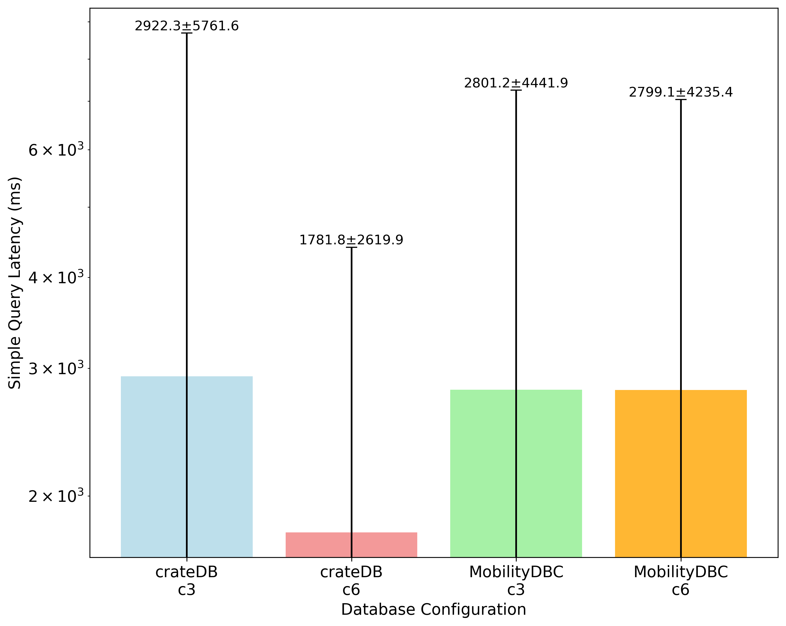
Results: Simple Queries 128 Workers

Slide 20
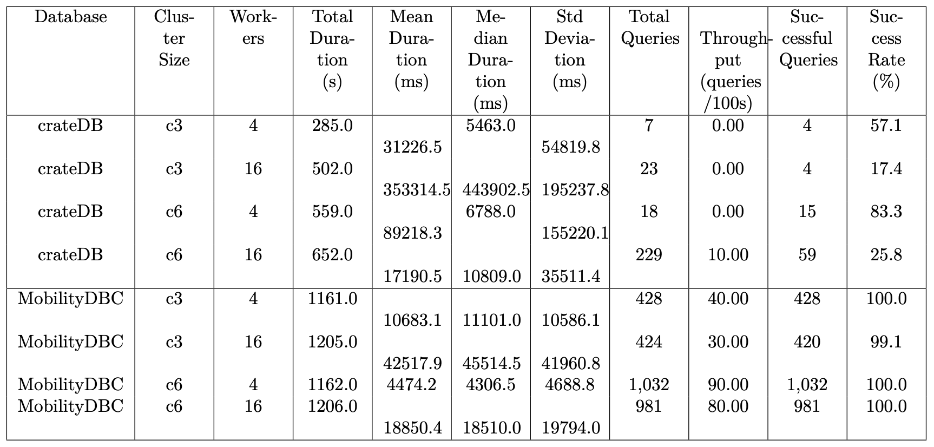
Results: Complex Queries

Slide 21
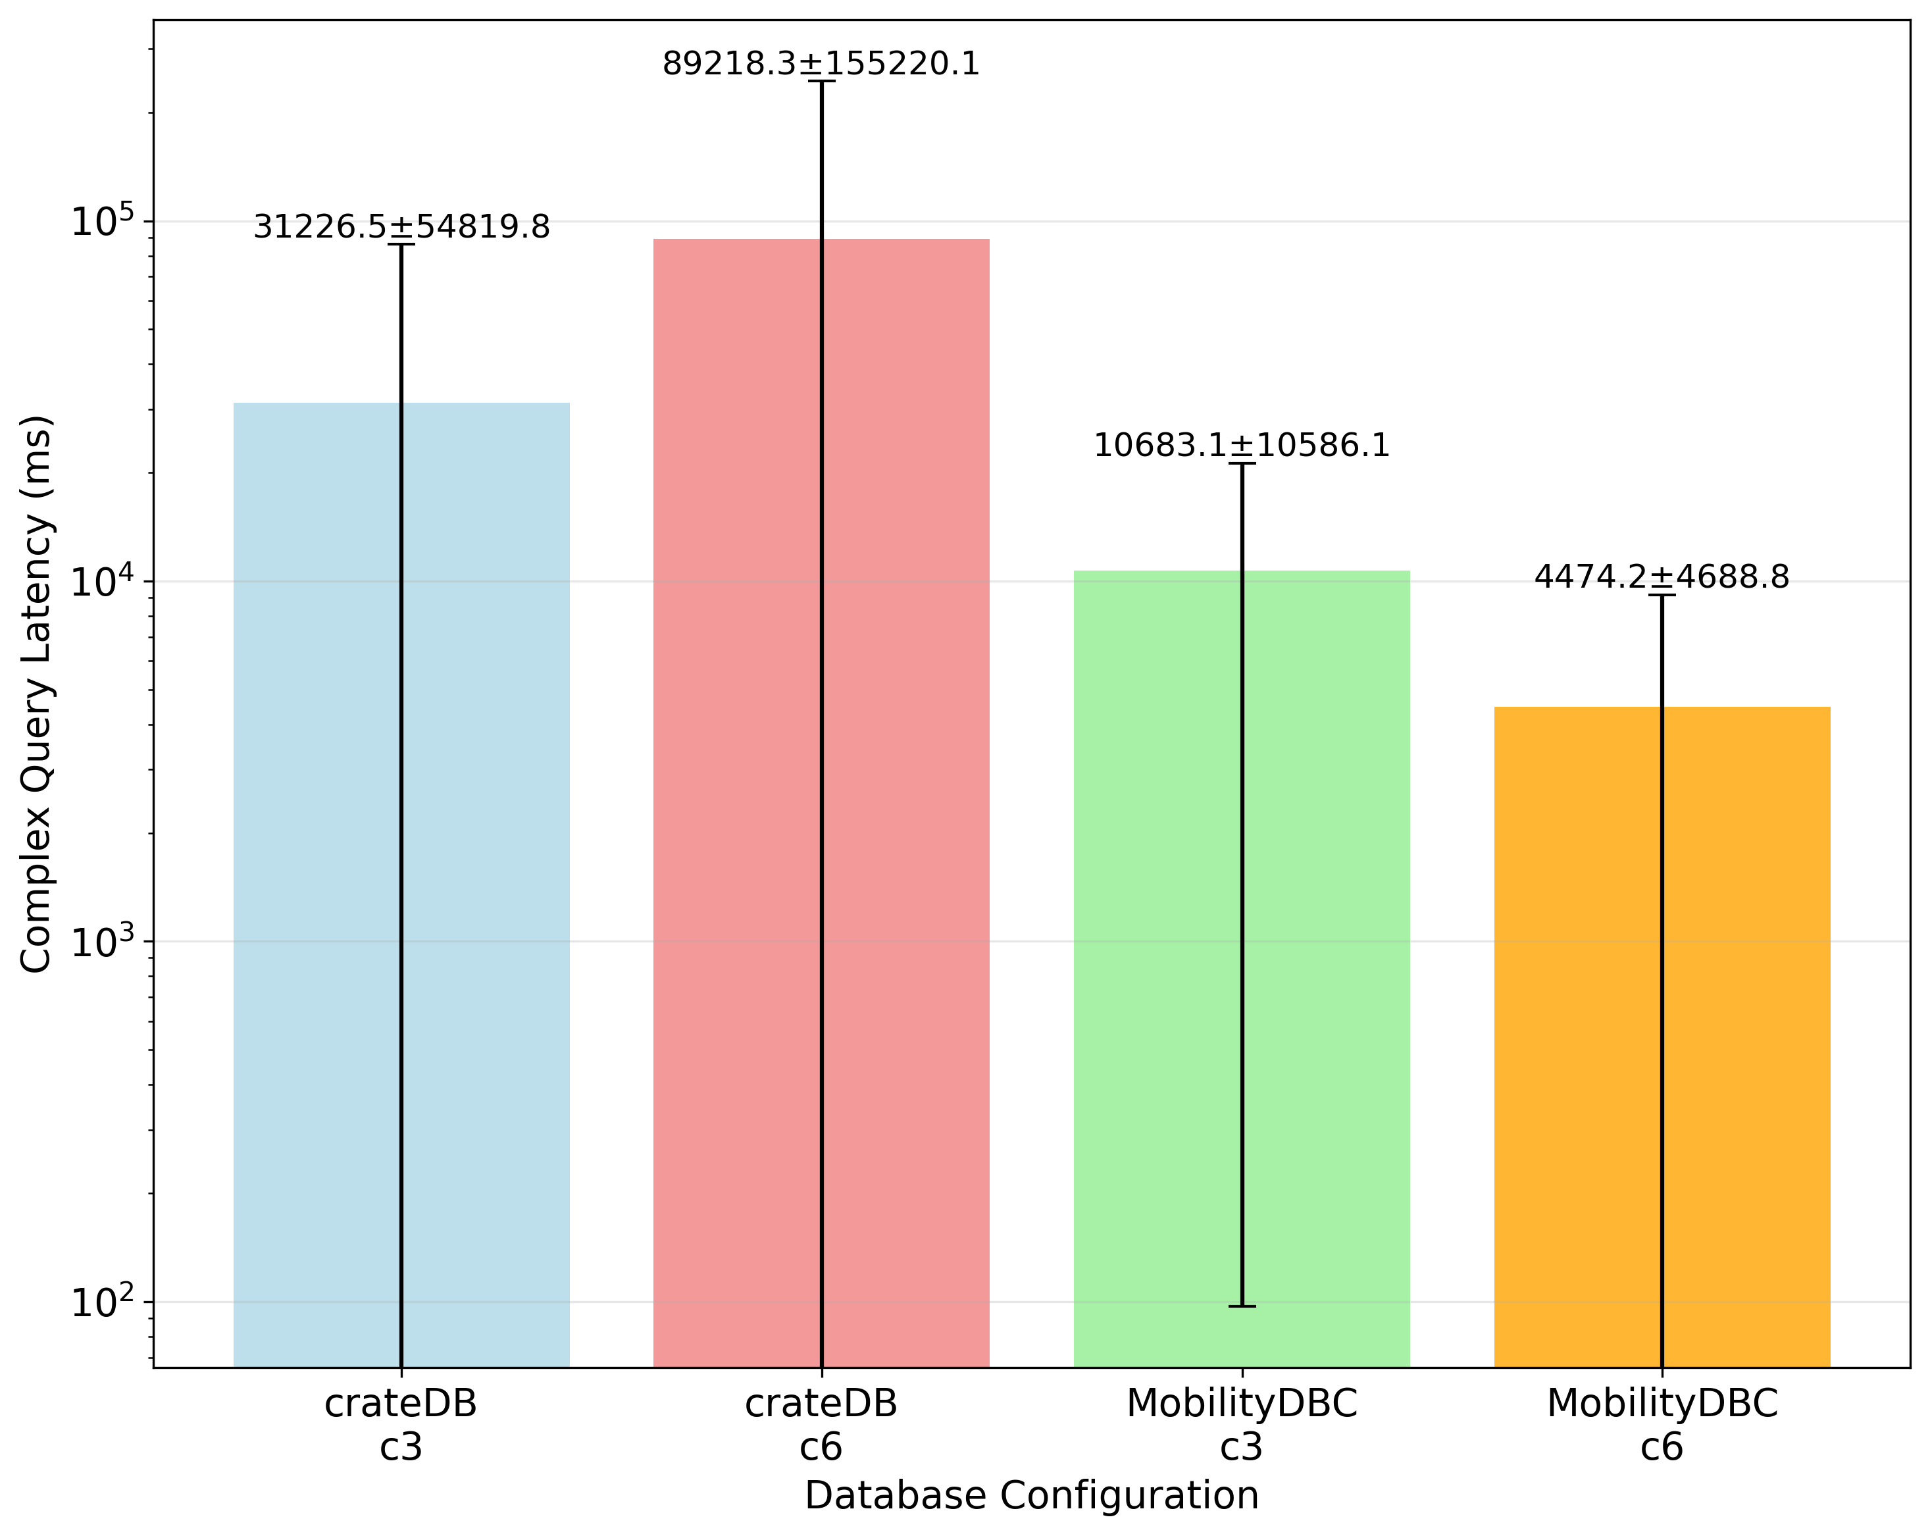
Results: Complex Queries 4 Workers

Slide 22
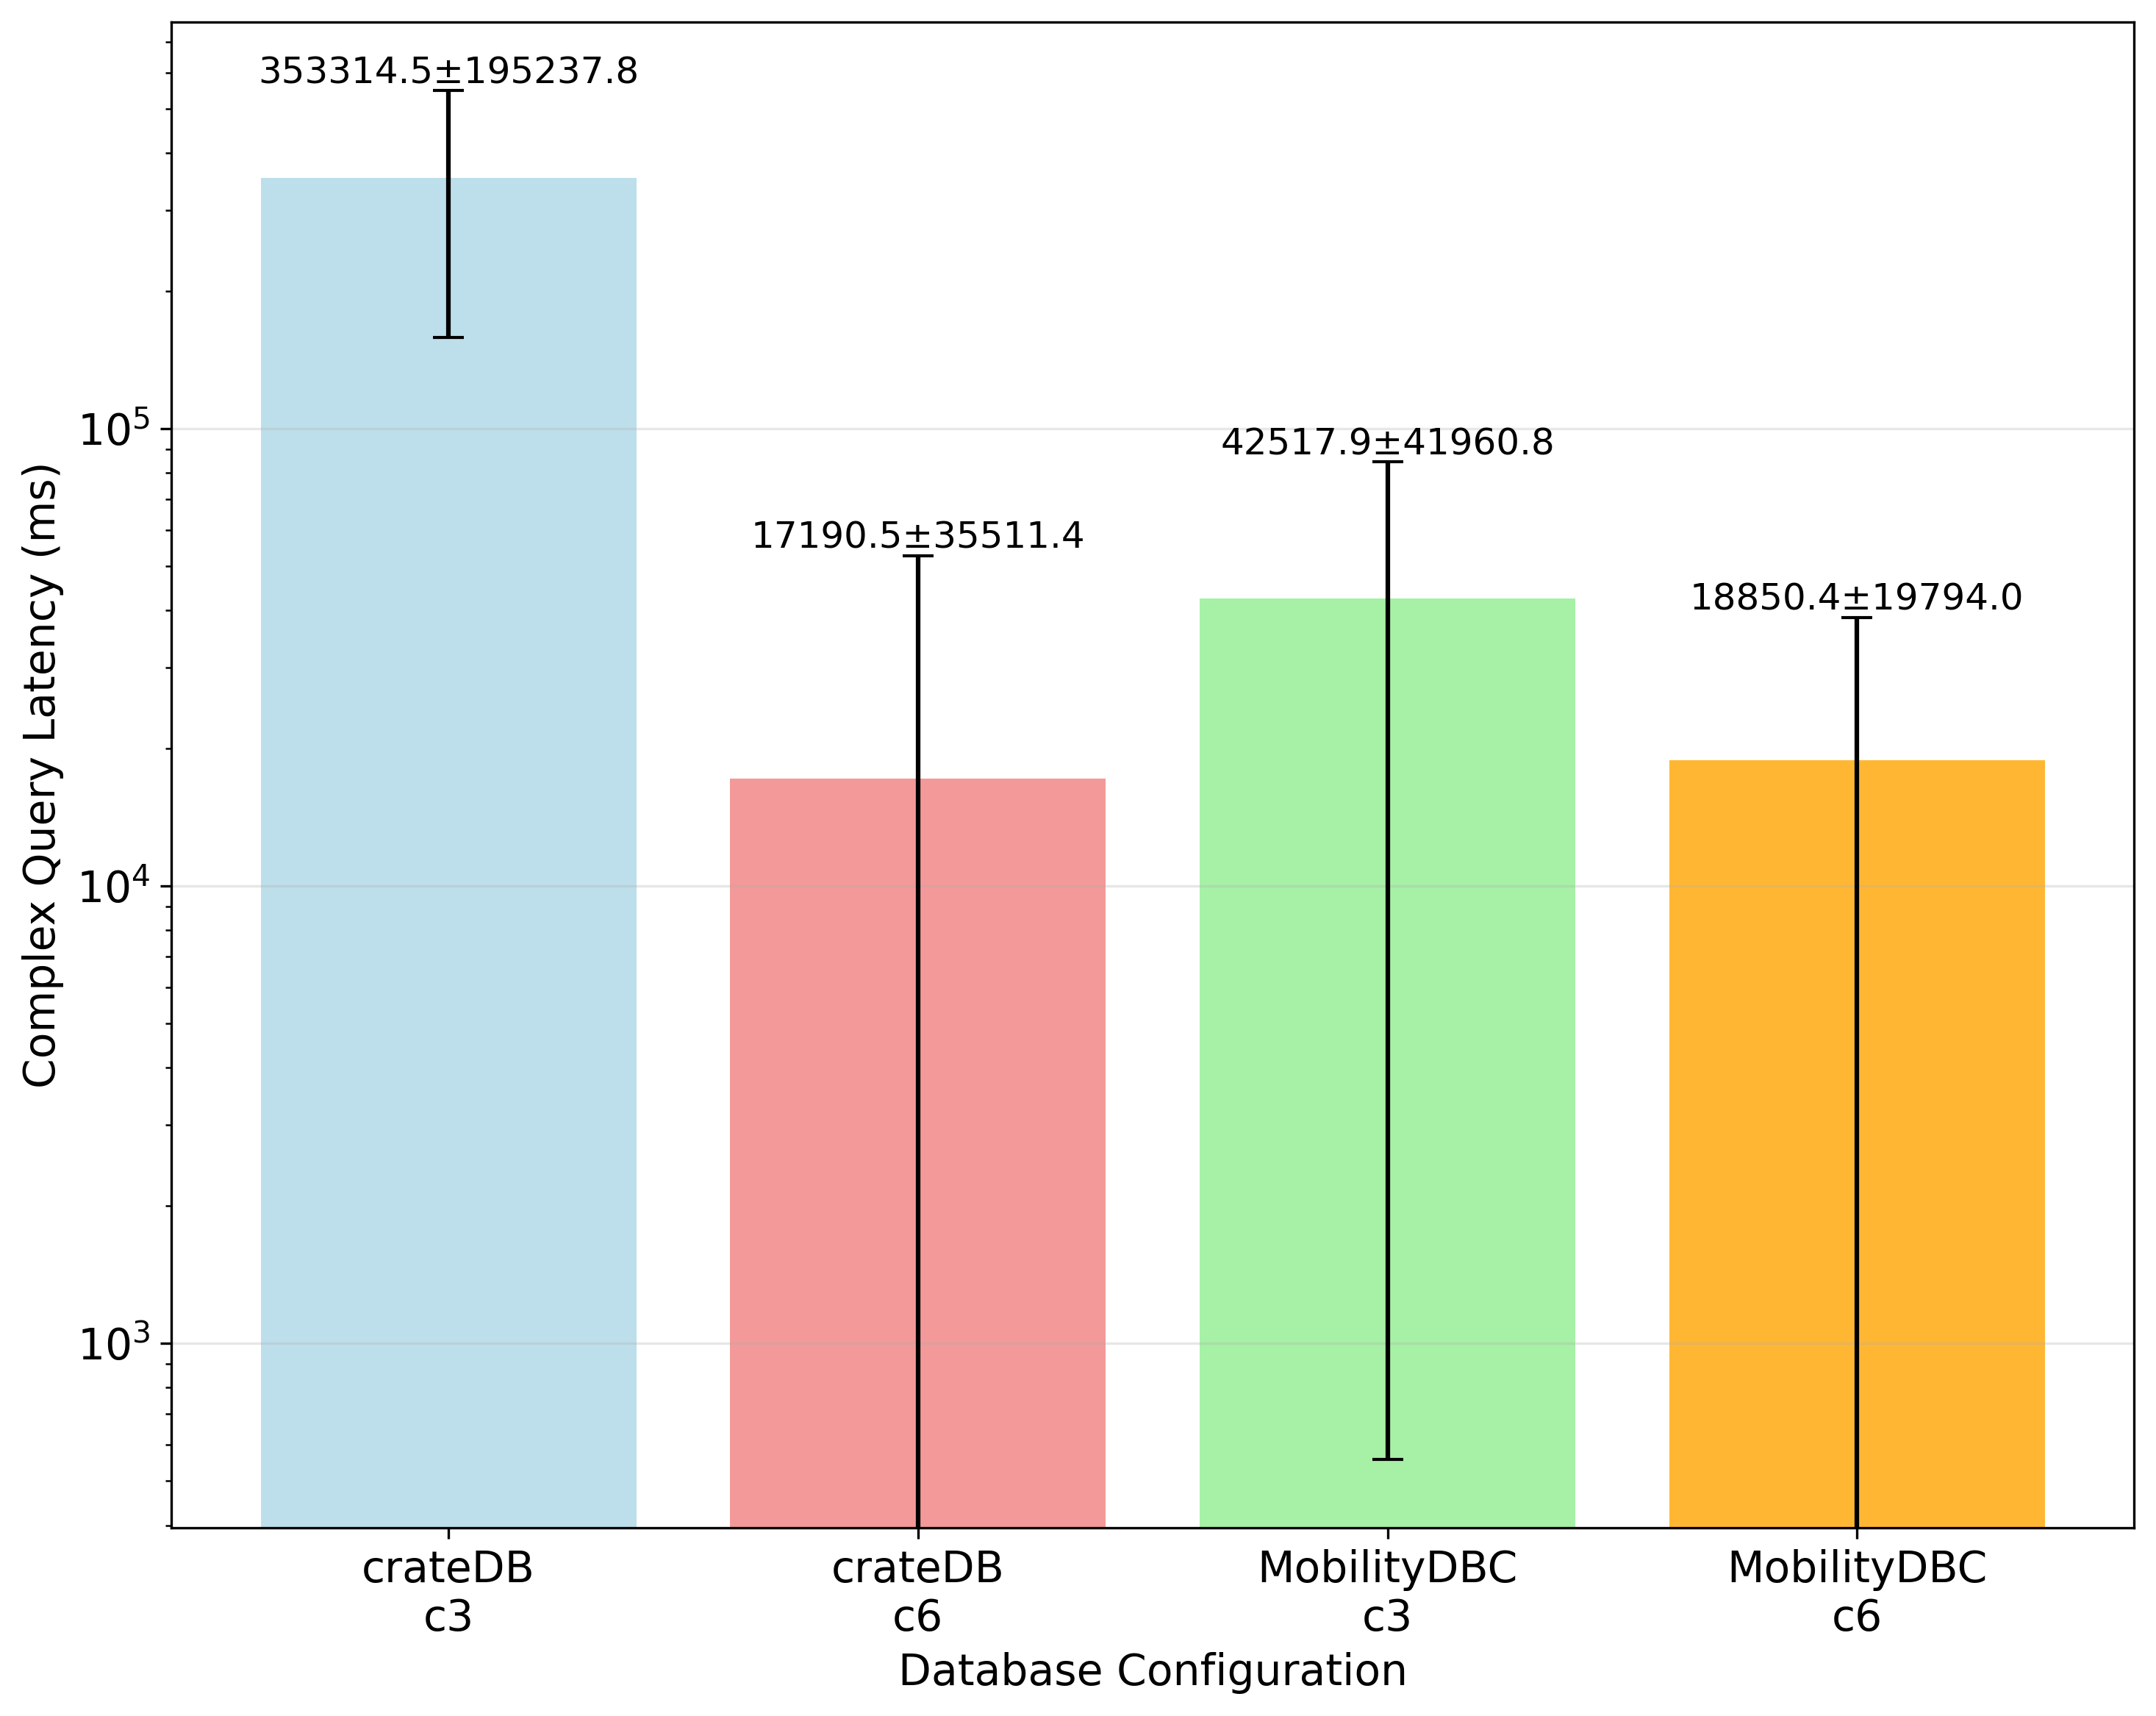
Results: Complex Queries 16 Workers

Slide 23
Thank you for your attention
and
special thanks to my advisor Tim Rese

Slide 24
References
[1] ניימן — “קורקינטיים חשמליים.” ניימן June 2019. Available at: https://www.neiman.co.il/2019/06/14812. License: not stated. Accessed: 4 Sep 2025.
[2] Pexels — “Google Maps Location Map Maps” (Photo ID: 2386132). Available at: https://www.pexels.com/photo/google-maps-location-map-maps-2386132. License: Pexels License. Accessed: 4 Sep 2025.
[3] Enrique Dans — “Buses will electrify urban public transportation.” Medium (Enrique Dans), 23 Dec 2018. Available at: https://medium.com/enrique-dans/buses-will-electrify-urban-public-transportation-94cc4a33574c. License: Creative Commons Attribution 4.0 International (CC BY 4.0). Accessed: 4 Sep 2025.
[4] Duul Wallpaper — “Plane Images.” Blogspot, 23 Oct 2013. Available at: https://dulwlpaper.blogspot.com/2013/10/plane-images.html. License: not stated. Accessed: 4 Sep 2025.
[5] Marco Verch — “Nahaufnahme von unten: viele ordentlich geparkte Lime E-Scooter in Köln.” foto.wuestenigel.com. Available at: https://foto.wuestenigel.com/nahaufnahme-von-unten-viele-ordentlich-geparkte-lime-e-scooter-in-koln. License: Creative Commons BY 2.0. Accessed: 4 Sep 2025.
[6] PxHere (photographer not listed) — “Port container ship at pier” (Image ID: 820915). PxHere. Available at: https://pxhere.com/ko/photo/820915. License: CC0 Public Domain. Accessed: 4 Sep 2025.
[7] REDAZIONE — “Amazon punta su Deliveroo per conquistare il food delivery.” inNaturale, 8 July 2019. Available at: https://www.innaturale.com/amazon-punta-su-deliveroo-per-conquistare-il-food-delivery. License: Creative Commons BY-NC-ND 3.0 (per site footer). Accessed: 4 Sep 2025.

